Slide 1

QUIZ GAME Mini project
.

Slide 2
Programming in ‘c’
Submitted to : DR PIYUSH PRATAP SINGH
Submitted by: KOMAL KUMARI
Enrollment number : 22/10/JC/002
School of computer and systems sciences

Slide 3

OBJECTIVE OF THIS GAME IS TO REACH AT THE MAXIMUM POINT TO WINNING THE GAME

Slide 4

TOPIC WHICH IS USED IN THIS GAME
C
HEADER FILE- STDIO.H
STDLIB.H
Exit function
FUNCTION-
CONDITIONAL STATEMENT-
GETS FUNCTION-READING CHARACTER FROM THE (STDIN) AND STORES THEM AS A C STRING INTO STR UNTILL A NEWLINE CHARACTER OR THE END OF FILE IS REACHED
FFLUSH(STDIN)-USED TO FLUSH THE OUTPUT BUFFER OF STREAM

Slide 5
HERE WE ARE DOING SIMPLE QUIZ GAME
FIRST A WELCOME MESSAGE SHOWN
PROMPT YOUR NAME
THEN GREETING MESSAGE SHOWN
SOME BASIC RULES OF QUIZ APPEAR READ CAREFULLY
START GAME BY ANSWERING
EVERY TIME YOU HAVE TO CHOOSE THAT YOU WANT TO PALY OR QUIT THE GAME IN BETWEEN
FOR EACH CORRECT ANSWER YOU GOT 10 POINTS
AND FOR EVERY INCORRECT ANSWER GOT NOTHING
MAXIMUM POINTS IS 100 IF YOU SCORE BETWEEN 100 TO 40 YOU WON THE QUIZ
IF YOU SCORE BETWEEN 40 TO 10 YOU LOST THE QUIZ AND GAME IS OVER

Slide 6
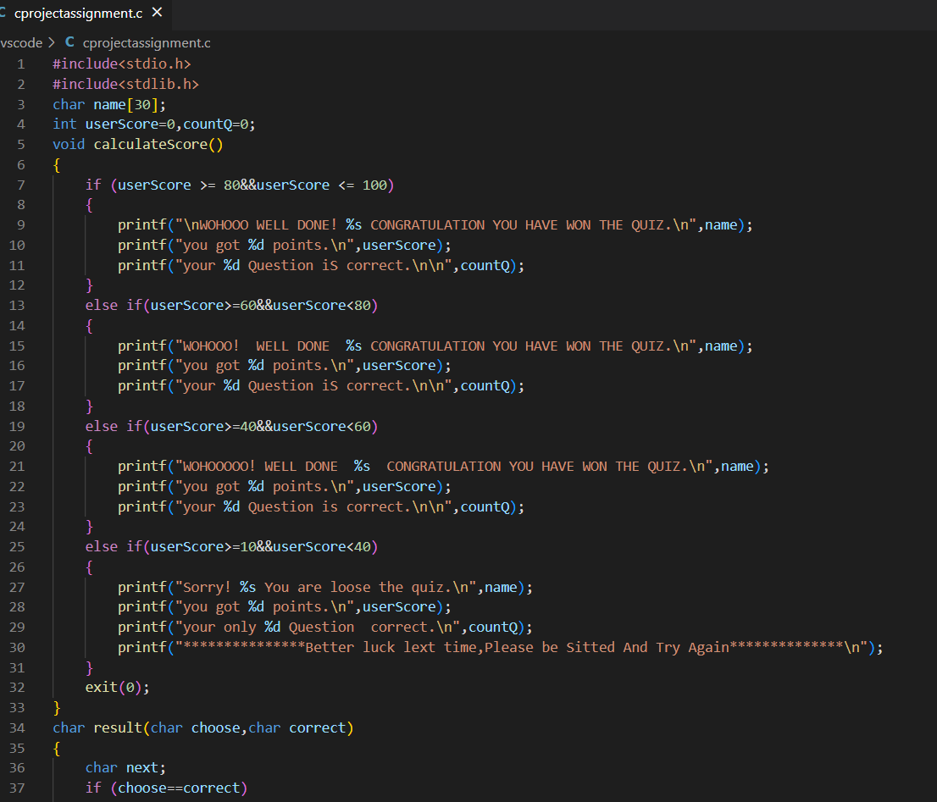
. CODE FOR THE QUIZ

Slide 7
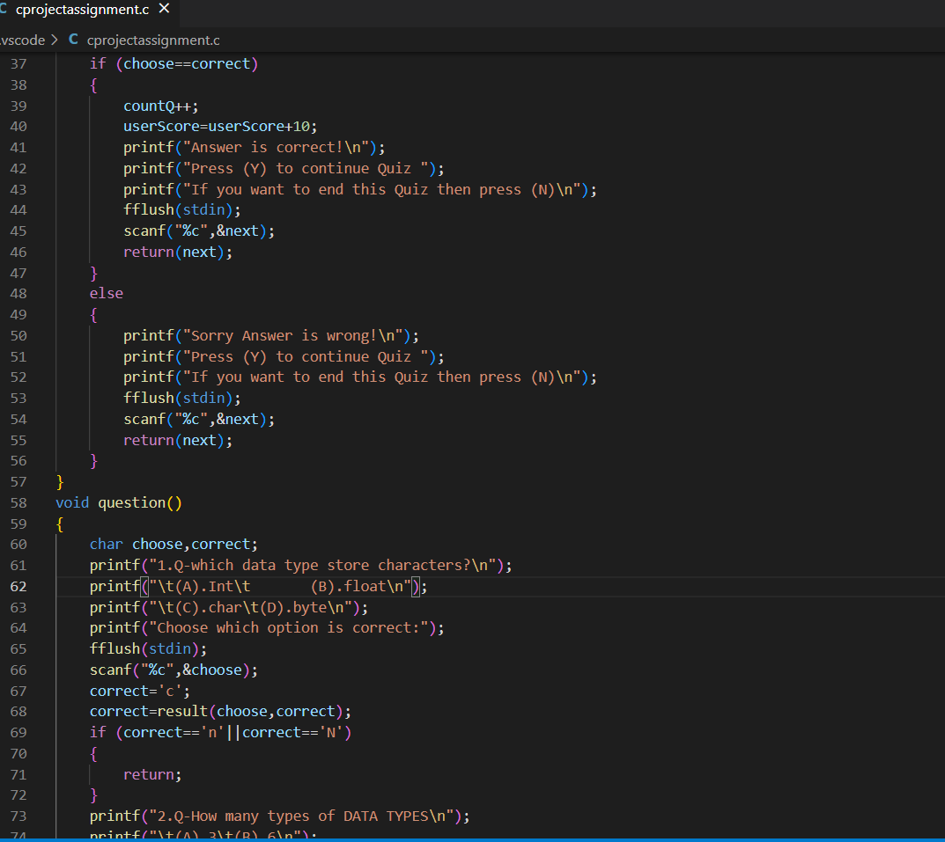
.
Here number of question is 10 YOU HAVE TO ANSWER MAXIMUM NUMBER OF QUESTION IF YOU SCORE BETWEEN 100 TO 40 YOU WILL WIN THE GAME OTHERWISE YOU LOOSE

Slide 8
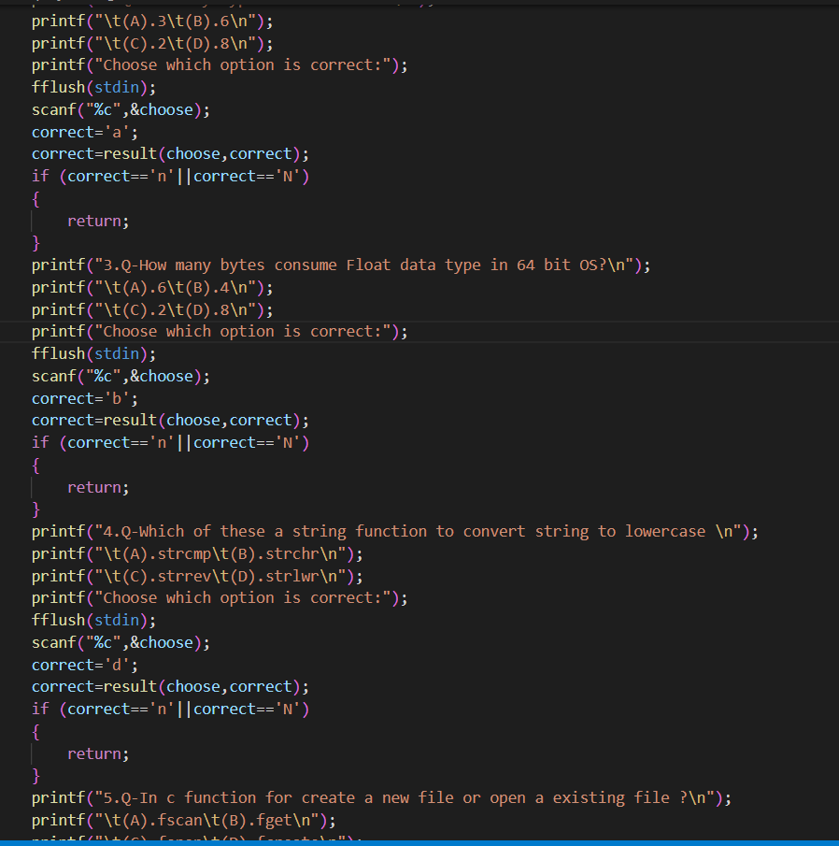


Slide 9
Question based on c

Slide 10
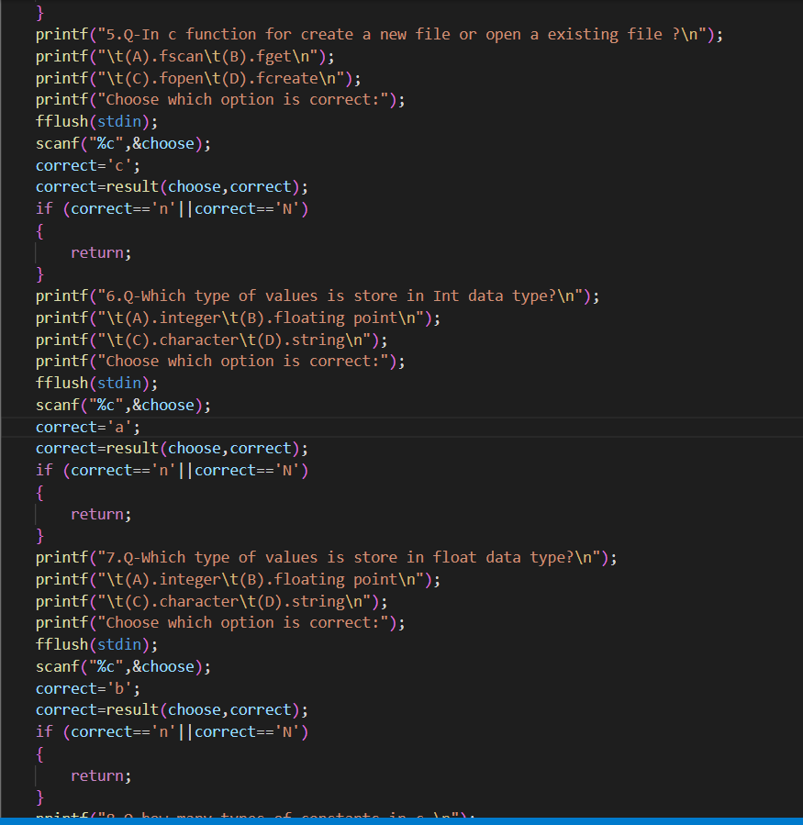
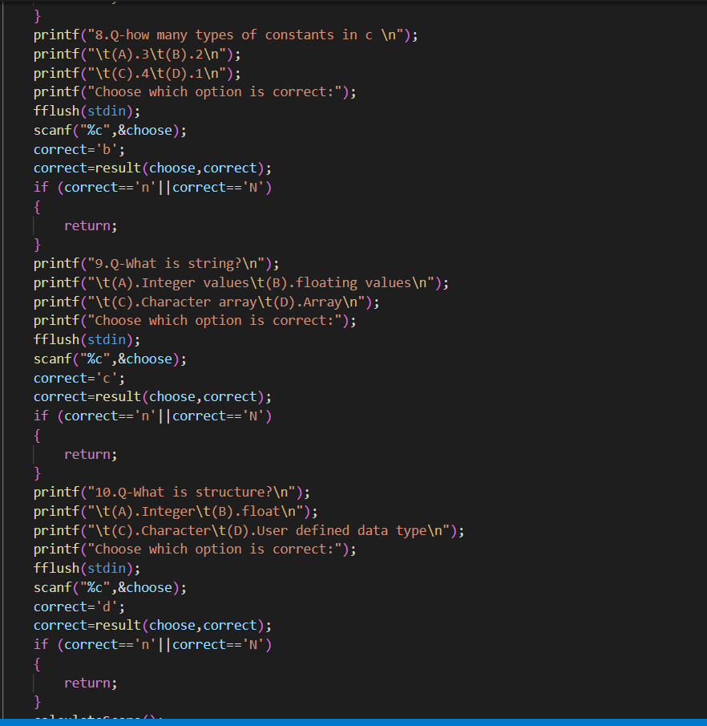

Slide 11
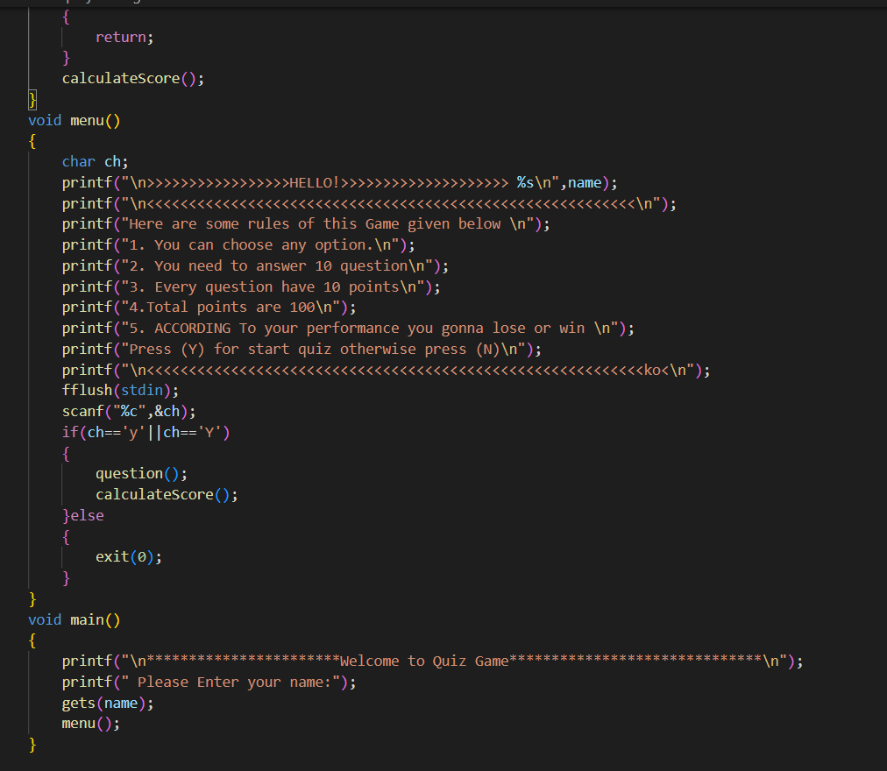
Just be seated and play patiently

Slide 12
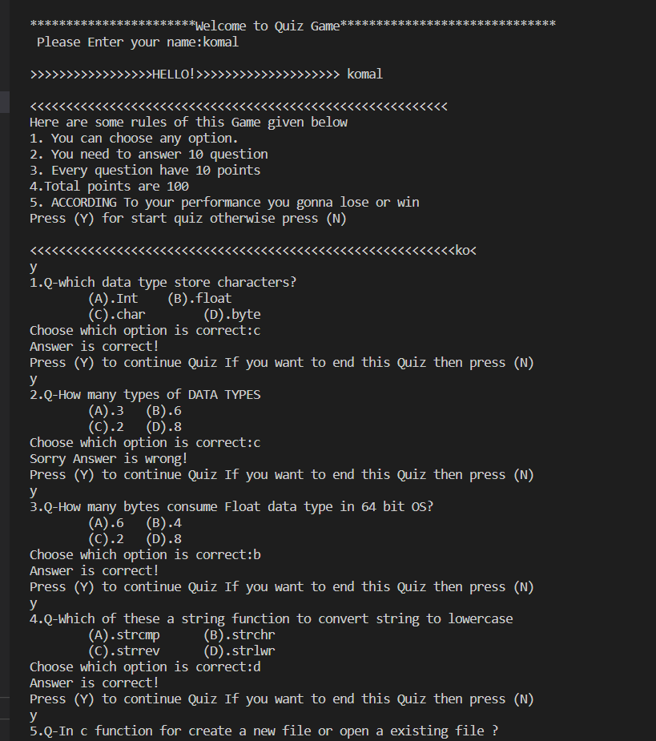
THE OUTPUT IS GENERATED AS

Slide 13
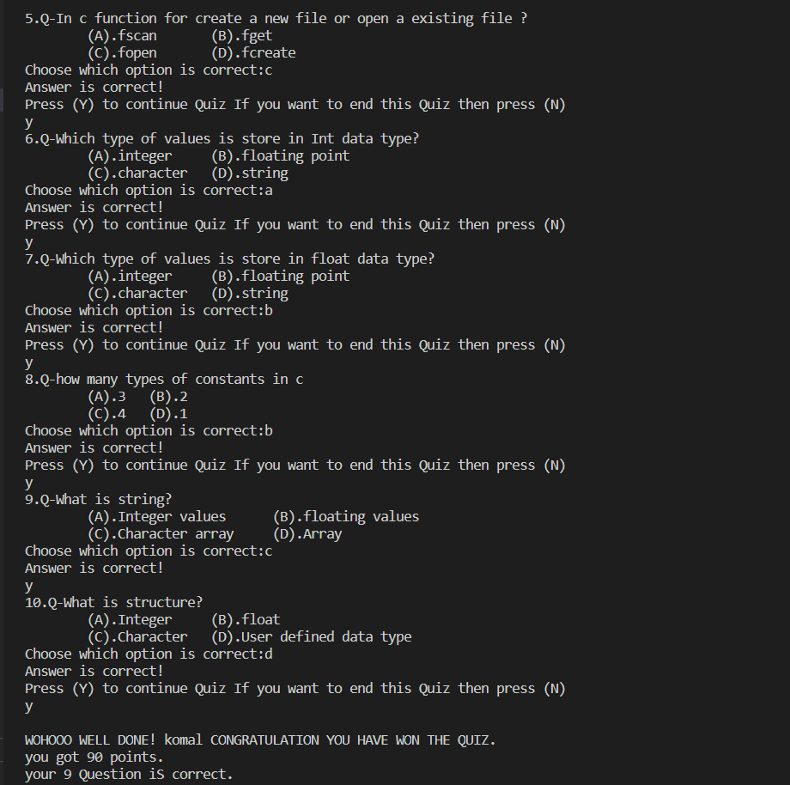


Slide 14

KEEP PLAYING
THANK YOU

